Slide 1

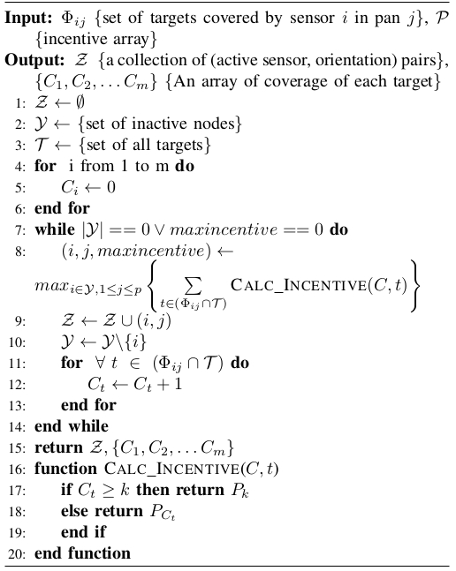
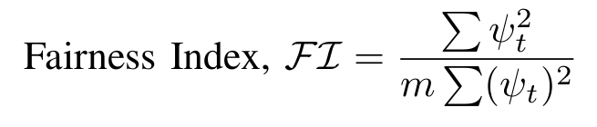
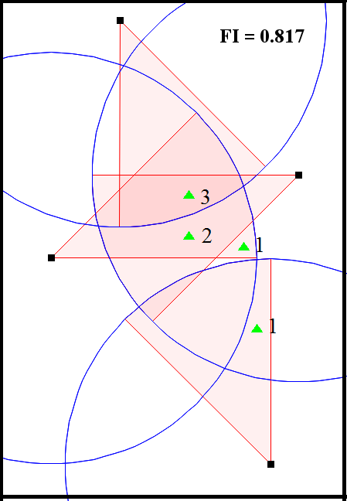
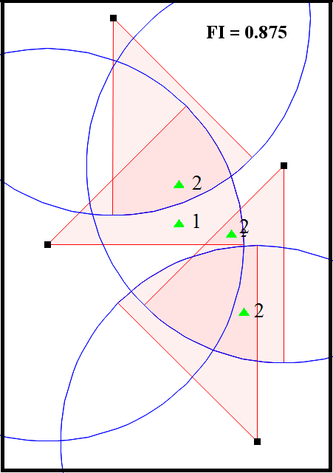
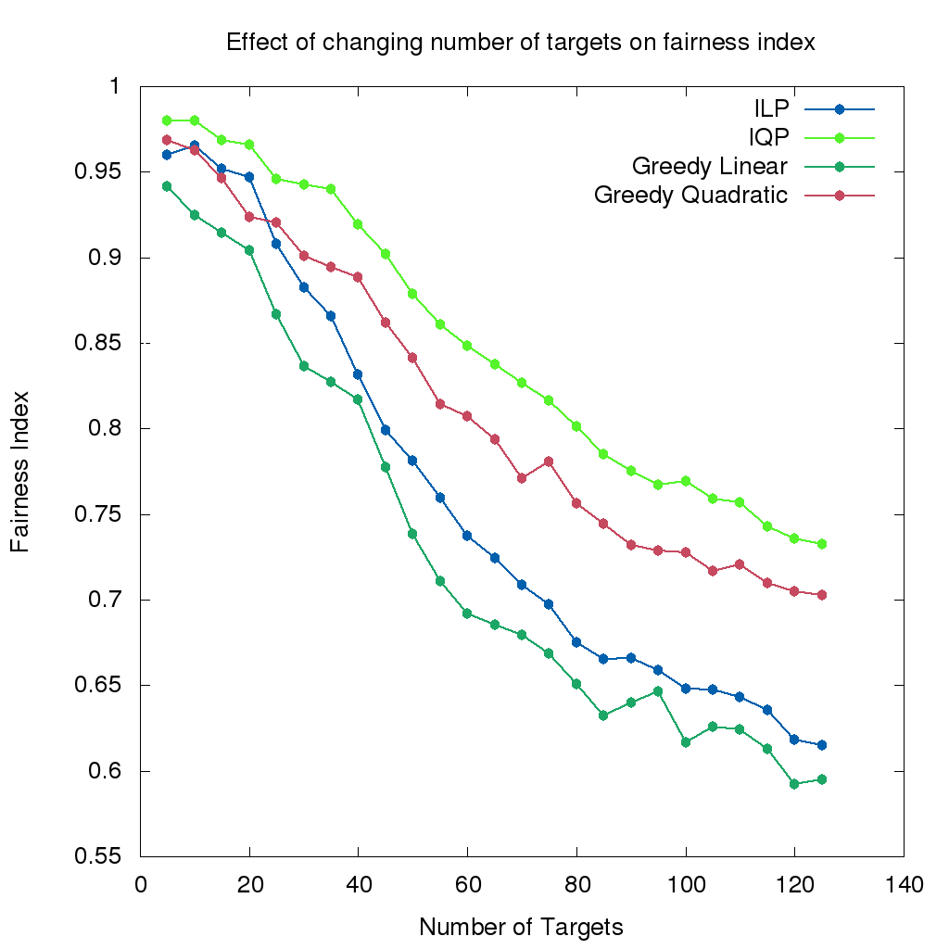
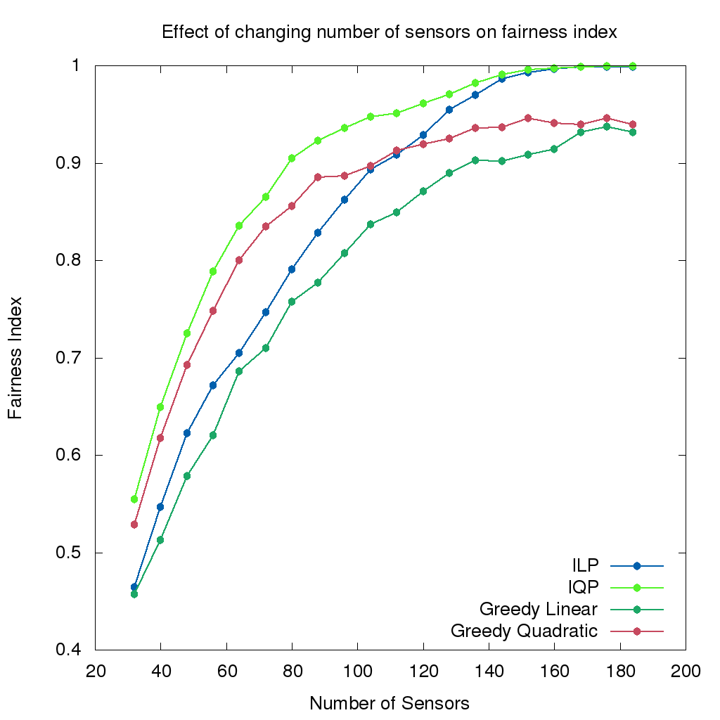
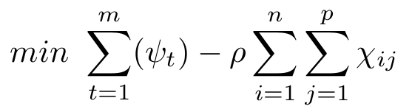
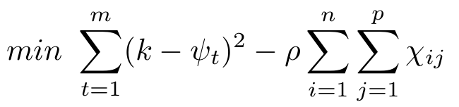
Balanced k-Coverage in Visual Sensor Networks
Md. Muntakim Sadik, Sakib Md. Bin Malek
Email: {0905003.mms, 0905039.smbm}@ugrad.cse.buet.ac.bd
Problem Definition:
Directional sensors, like cameras, are used to cover targets for different purposes.
If a sensor becomes out of order, many targets may be left uncovered, therefore some level of fault tolerance is needed.
In k-coverage problem, each target are to be covered k times.
In an under provisioned or critically provisioned system, imbalance in coverage of targets can be problematic.
Our work focuses on how to devise a balanced k-coverage in such systems.
Central Greedy k-Coverage Algorithm
Balanced k-Coverage:
Raj Jain et al [1] formulated a fairness index, that can determine the fairness in resources allocation.
ψ_{t} is the number of times t^{th} target has been covered and m is the total number of targets.
Fairness Index reflects the balance of coverage of targets in a k-coverage problem.
Result Analysis:
We ran simulations with k = 3. Incentive values used in Greedy Linear and Greedy Quadratic are {1, 1, 1, 0} and {5, 3, 1, 0} respectively.
As the ratio of targets to sensors increased, the scenario gradually became an under provisioned one, thus the fairness index decreased. The opposite can be seen when the number of sensors were increased keeping the number of targets constant.
Our Contribution:
By modifying the constrains of Integer Linear Programming (ILP) of Maximum Coverage Minimum Sensors [2], we changed the 1-coverage problem formulation to k-coverage problem formulation. Objective function of ILP formulation of k-coverage:
In our scenarios, there are n sensors, each with p non-overlapping pans. The variable, χ_{ij}, is 1 if i^{th} sensor is active in the j^{th} pan, 0 otherwise. ρ is a positive penalty factor.
ILP formulation shows poor fairness in the coverage of targets. Thus, we introduced Integer Quadratic Programming (IQP) formulation, which is much better in achieving balanced coverage. Objective function of IQP formulation of k-coverage:
However, optimal k-coverage is an NP-complete problem [3]. Therefore, neither ILP nor IQP can be used in larger scale problems.
We propose Central Greedy k-Coverage Algorithm (CGkCA).
CGkCA can be used for both ILP and IQP by slightly modifying the values of incentive array, C, which is given as input.
The values of C is chosen in such a way that it resembles the incentive values of each coverage of target in ILP and IQP.
Figure 2: Our desired dissemination scenario
Conclusion and Future Work:
Much work has been done on k-coverage. However, the researchers have overlooked the imbalance in the k-coverage problem.
Our proposed greedy algorithm provides a much more balanced solution to the k-coverage problem and it can also be used to solve large scale problems.
In future, we are optimistic that higher order polynomial functions can be used to obtain better results.
References:
[1] Raj Jain, Dah-Ming Chiu, and William Hawe. A quantitative measure of fairness and discrimination for resource allocation in shared computer systems. 1998.
[2] Jing Ai and Alhussein A Abouzeid. Coverage by directional sensors in randomly deployed wireless sensor networks. Journal of Combinatorial Optimization, 11(1):21–41, 2006.
[3] Giordano Fusco and Himanshu Gupta. Selection and orientation of directional sensors for coverage maximization. In Sensor, Mesh and Ad Hoc Communications and Networks, 2009. SECON’09. 6th Annual IEEE Communications Society Conference on, pages 1–9. IEEE, 2009.
Department of Computer Science and Engineering (CSE), BUET

